Slide 1

Smart Forest Fire Detection System
Final Project - Viva
Higher Diploma in Software Engineering
School of Computing and Engineering
National Institute of Business Management

Slide 2
Introduction
Domain Overview
Forest fires cause devastating damage to ecosystems, wildlife, and economies worldwide.
Global warming is increasing the frequency and severity of wildfires significantly.
Problems Identified
Manual patrols & satellite systems are too slow for early detection.
No ground-level continuous monitoring in dense forest areas.
Existing systems are expensive with no predictive capabilities.
Remote areas lack sustainable long-term power solutions.
Our Solution
A self-driven, solar-powered, IoT-based robotic system designed to continuously monitor forest environments for fire risk. It combines autonomous robotics, multi-sensor fusion, machine learning, GPS tracking, and cloud-based real-time alerting into one integrated platform.

Slide 3
Research Gap
Kumar (2020)
Detected fire only after ignition. Could not predict risk in advance. No autonomous movement.
Liu (2019)
GPS tracking available but no severity classification or sustainable power for remote areas.
Rao (2022)
Focused only on gas sensor accuracy. No autonomous movement or real-time notifications.
Jain & Sharma (2021)
ML wildfire prediction using satellite data only — less granular and with delayed response.

Slide 4
Introduction to the Innovative Solution
Innovative Features
Ground-level forest floor patrol
Detects risk before fire starts
5-sensor fusion for accuracy
Live severity classification
Solar - no power dependency
Instant GPS-tagged cloud alerts
Solution Outline
Solar-powered autonomous ESP32 robot
Flame, MQ-9 Gas, DHT11, Rain sensors
GPS real-time fire location tracking
Web dashboard + Mobile app alerts
Firebase cloud database
24/7 off-grid forest operation

Slide 5
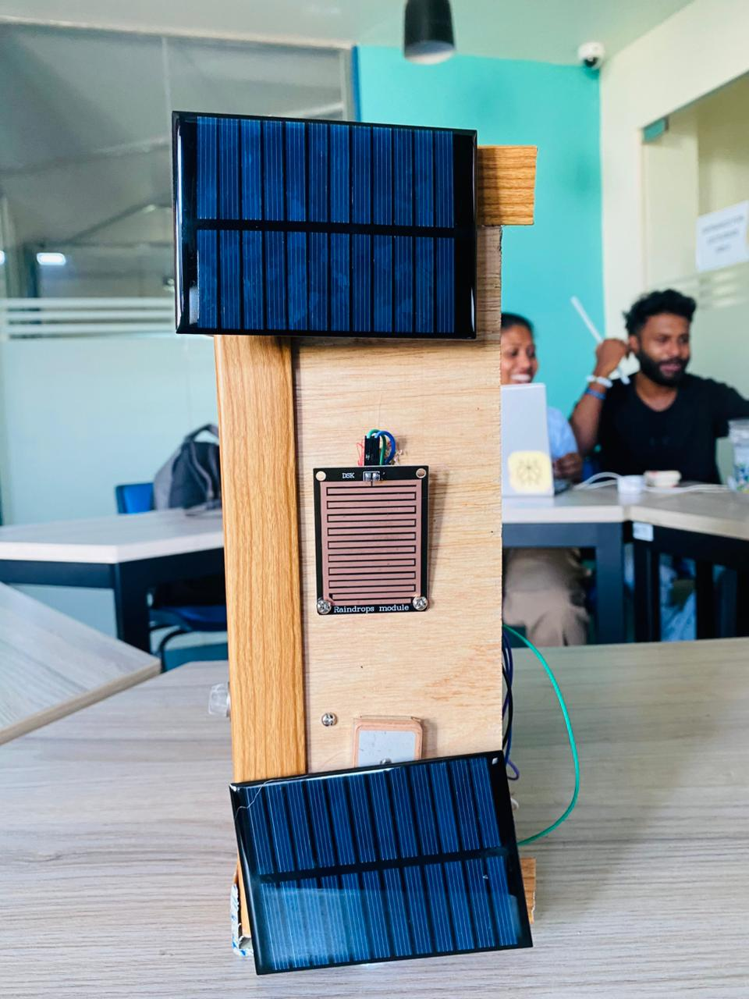
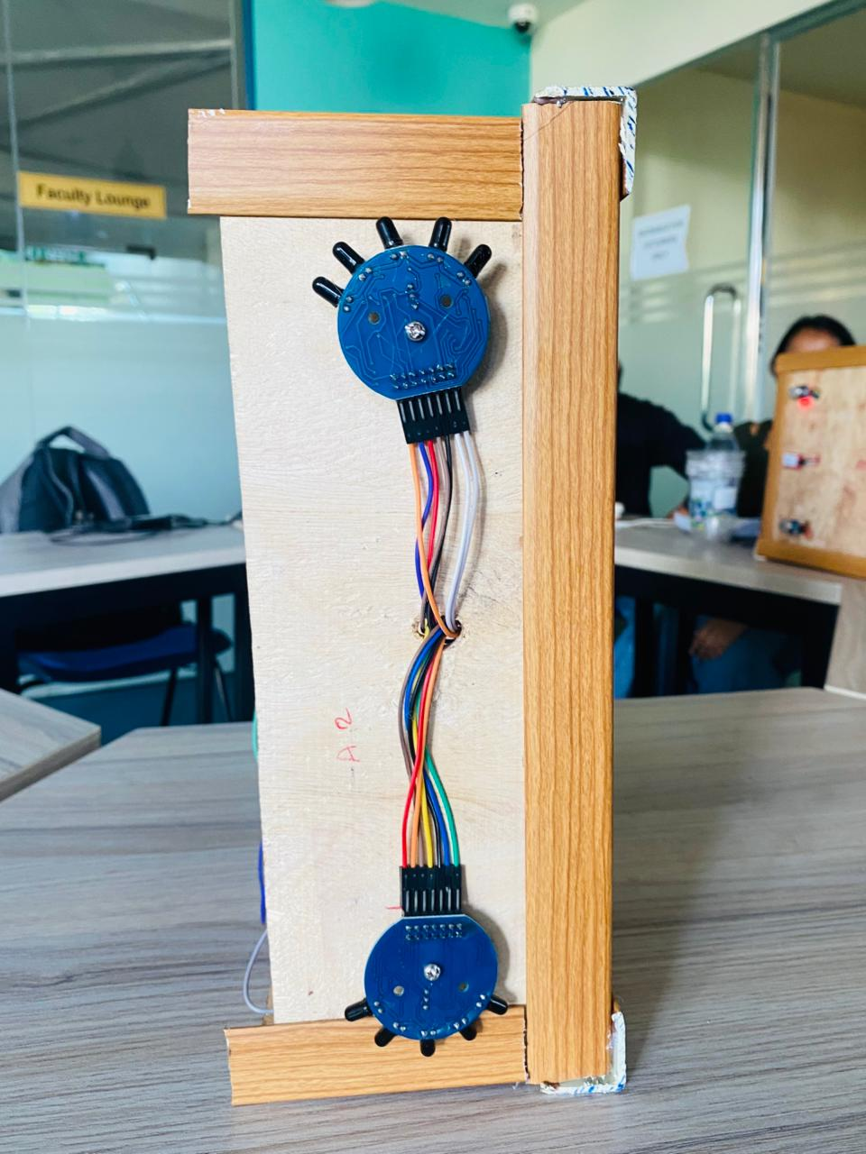
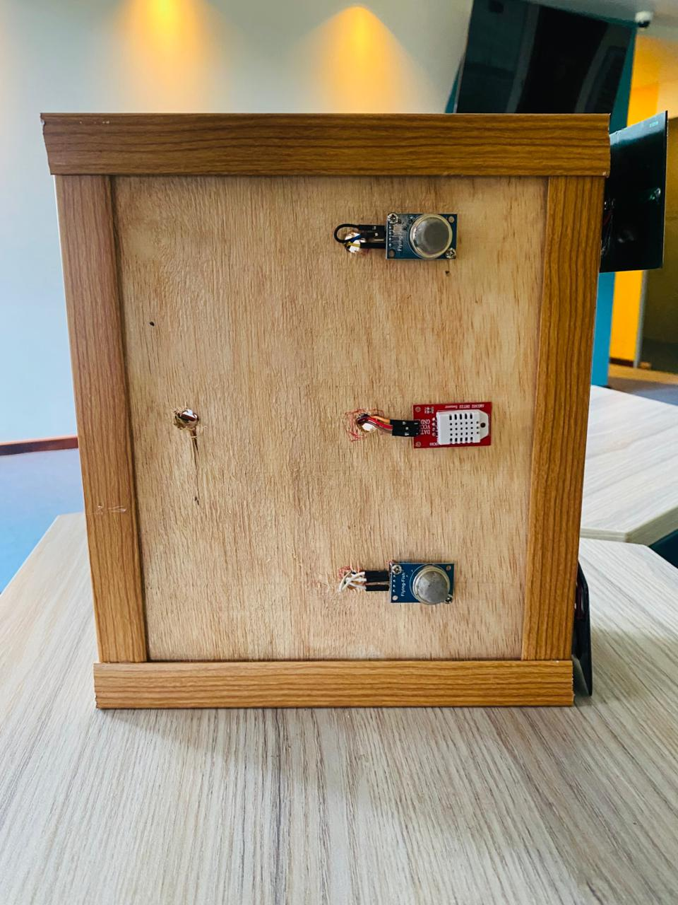
Innovative Solution
Solution Demo

Slide 6
Cost of Solution Development
Software Tools (Free / Open Source)
Hardware Cost (LKR)
Arduino IDE, VS Code — Free
React.js, React Native — Free
Firebase (Free tier) — LKR 0
Python (ML) — Open Source
GitHub — Free
Component | Cost (LKR)
ESP32 Microcontroller | 3,500
MQ-9 Gas Sensor | 1,500
Flame Sensor | 600
DHT11 Temp/Humidity Sensor | 500
Rain Sensor | 700
GPS Module | 3,000
Camera Module | 2,500
Solar Panel + Battery | 6,000
Robot Chassis + Motors | 5,200
TOTAL | 24,500
Development Effort
4 developers × 3 months
Agile sprints (2-week cycles)
~480 person-hours total
Prototype cost: LKR 24,500

Slide 7
Target Market and Business Model
Main Clients / Users
Forest Departments
Government forest officers needing real-time fire risk data and autonomous patrol coverage.
Environmental Authorities
National agencies managing protected areas, wildlife sanctuaries, and national parks.
Disaster Management Units
Emergency response teams requiring GPS-tagged severity-classified fire alerts.
Revenue Generation Methods
Hardware Sales
Sell complete robotic units to government departments and environmental agencies as turnkey solutions.
SaaS Subscription
Monthly / annual subscription fee for cloud dashboard, mobile app, and ML model updates.
Maintenance Contracts
Annual service contracts for hardware maintenance, calibration, and system upgrades.
Scale & Export
Expand to international markets - wildfire-prone regions in Asia, Australia, and Europe.

Slide 8
Group Details
Group 04
Group Members:
COHNDSE251F-027 P.D.D.S. Kulasekara
COHNDSE251F-029 H.H.A.M. Sethumika
COHNDSE251F-030 C. H. Amarasinghe
COHNDSE251F-031 W. R. D. I. Sandeepani

